Slide 1
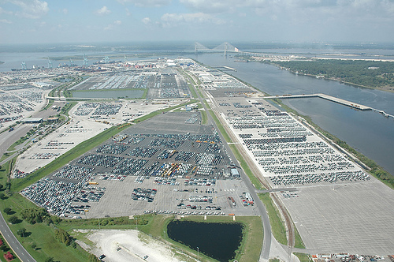
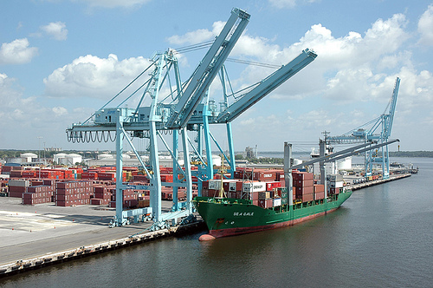
JACKSONVILLE HARBOR DEEPENING STUDY ECOLOGICAL AND WATER QUALITY MODELING
Presented by:
Jason Harrah, Project Manager, USACE, Jacksonville District
Steve Schropp, Senior Scientist, Taylor Engineering, Inc.
October 25, 2012
BUILDING STRONG®
BUILDING STRONG®
US ARMY CORPS OF ENGINEERS | Jacksonville District
U.S. ARMY CORPS OF ENGINEERS | Jacksonville District

Slide 2
ECOLOGICAL MODELING STUDY TEAM
2
U.S. ARMY CORPS OF ENGINEERS (USACE)
Jason Harrah (PM)
Steven Bratos P.E., Senior Engineer
Paul Stodola, Senior Biologist
Mike Hollingsworth, Senior Biologist
TAYLOR ENGINEERING
Steven Schropp, Ph.D. (PM)
David Stites, Ph.D.
Michael Kabiling, Ph.D., P.E.

Slide 3
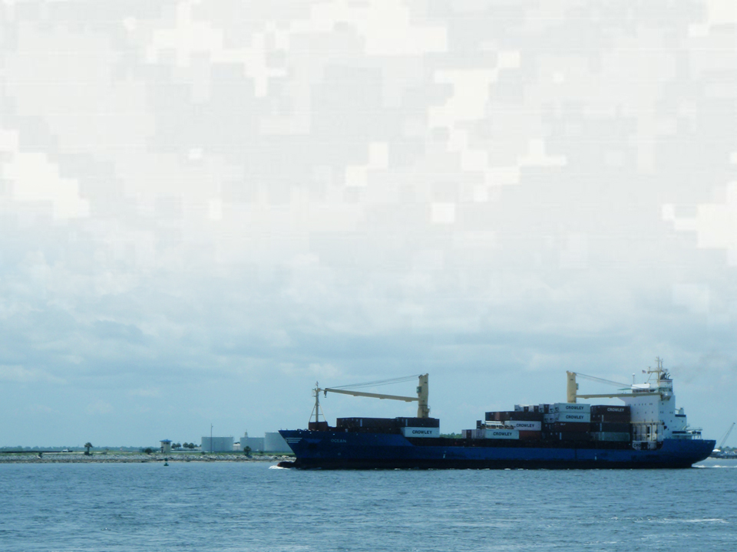
STUDY OVERVIEW
3
Jacksonville Harbor is located in Duval County beginning at the mouth of the St. Johns River where it joins the Atlantic Ocean
The harbor provides access to deep draft vessel traffic using terminal facilities located in the City of Jacksonville
BUILDING STRONG®
US ARMY CORPS OF ENGINEERS | Jacksonville District

Slide 4
4
JACKSONVILLE HARBOR STUDY
AREA
Authorized Depths
Segments 1 and 2: 40 feet
Segment 3: 38 feet
FORT
GEORGE
ISLAND
FOCUS OF CURRENT STUDY
MAYPORT
50’
BEACH QUALITY
DREDGED
MATERIAL
PLACEMENT
Mile 13
BUCK ISLAND
OIL TERMINALS
JEA
FUEL DOCK
U.S. NAVY FUEL DEPOT
BLOUNT ISLAND
Segment 2
JPA DAMES POINT TERMINALS
Segment 3
JPA TERMINALS
JEA COAL
MILE POINT
MAYPORT NAVAL STATION
Segment 1
BUCK ISLAND
OIL TERMINAL
BARTRAM ISLAND
DREDGED MATERIAL
SITES
OIL TERMINAL
JPA TALLEYRAND
TERMINAL
MILL COVE
Mile 20
BUILDING STRONG®
US ARMY CORPS OF ENGINEERS | Jacksonville District

Slide 5
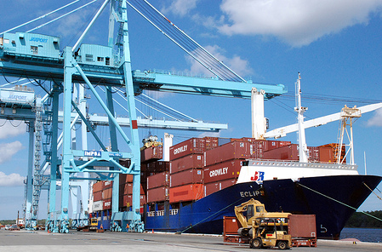
STUDY GOALS
5
Provide transportation costs savings
Develop most cost-effective means for placement of dredged material (over 50-year project life)
Accommodate existing and larger commercial ship traffic while minimizing impacts to environmental resources
BUILDING STRONG®
US ARMY CORPS OF ENGINEERS | Jacksonville District
Notes:
Provide transportation costs savings associated with draft restrictions to the existing authorized channel depth
Develop the most cost-effective means for disposal of dredged material over the 50-year project life
Identify the best plan that minimizes impacts to environmental resources and accommodates existing and larger commercial ship traffic
1. Transportation delays occur due to the existing conditions at Jacksonville Harbor. Vessels are restricted to the maximum depth of 40 feet, authorized project depth. Larger vessels must light-load or wait for tidal advantage to transit Jacksonville Harbor. This causes increased transportation costs. The 40-foot project depth impacts the introduction of larger vessels into the fleet. These impacts create transportation inefficiencies. Larger vessels are restricted to limited turning areas.

Slide 6
AGENCY AND PUBLIC COORDINATION EFFORTS TO DATE
6
May 2007: First Public Scoping Letter
February 2008: Feasibility Scoping Meeting
May 2009: Second Public Scoping Letter
May 2009: Public Workshop on Project Scope
March 2012: Interagency Meeting on Ecological Modeling
May 2012: Public Meeting on Ecological Modeling
July 2012: Initiated Monthly Interagency and Bi-Monthly Public Teleconferences
BUILDING STRONG®
US ARMY CORPS OF ENGINEERS | Jacksonville District

Slide 7
ANTICIPATED FUTURE INTERAGENCY AND PUBLIC MEETINGS *
7
Oct 2012: Ecological Modeling Preliminary Results Interagency and Public Meetings (Now)
November 2012: Agency Mitigation & Monitoring Planning Meetings
December 2012: Ecological Modeling Draft Report Interagency Meeting
Feb 2013: Rock Removal (Blasting) Public Meeting
May 2013: Draft Feasibility Report/Supplemental Environmental Impact Statement Public Meeting
Oct 2013: Final Feasibility Report/Supplemental Environmental Impact Statement Public Meeting
Monthly Interagency and Bi-Monthly Public Teleconferences
http://www.saj.usace.army.mil
* Study Updates and Public Participation Opportunities on Study Website
BUILDING STRONG®
US ARMY CORPS OF ENGINEERS | Jacksonville District

Slide 8
STUDY SCHEDULE (President’s Initiative)
8
April 2013: Draft Feasibility Report w/SEIS Complete
May 2013: Public Review Period
Oct 2013: Final Feasibility Report w/SEIS Complete
April 2014: Chief of Engineers Report
July 2014: ASA Letter to Congress and Record of Decision
TBD: Authorization Bill
BUILDING STRONG®
US ARMY CORPS OF ENGINEERS | Jacksonville District

Slide 9
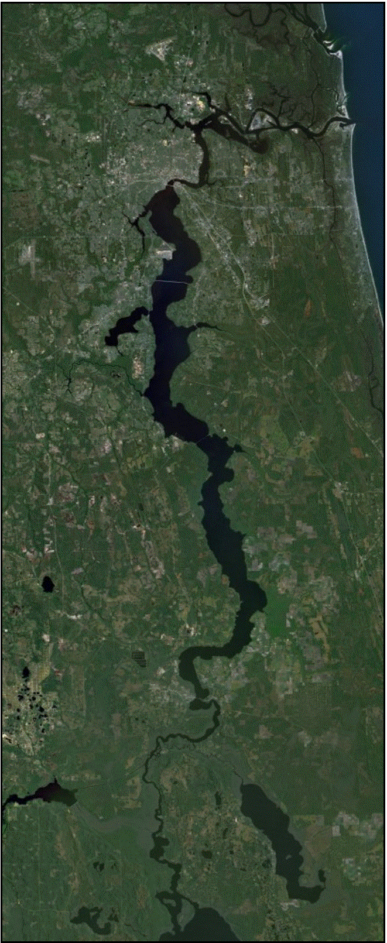
ECOLOGICAL MODELING OVERVIEW
9
Purpose
Support National Environmental Policy Act assessment
Study Area
River mouth to Lake George
Deeper channel could increase tidal exchange and cause:
Higher salinity in river
Changes in water circulation and residence time
Jacksonville
Mayport
Buckman Bridge
Shands Bridge
Palatka
Lake George

Slide 10
ECOLOGICAL MODELING OVERVIEW
10
Potential effects of salinity and circulation changes
Wetland communities shift location and acreage
Loss of eelgrass habitat and shift in habitat location
Shifts in location of optimal fish salinity ranges and related changes in habitat availability
Loss of low-salinity benthic macroinvertebrate (e.g., shrimp, crab, clams, mussels, worms) habitat and shift in habitat range
Changes in plankton blooms and resulting dissolved oxygen
St. Johns River Water Management District Water Supply Impact Study provides ecological model framework

Slide 11
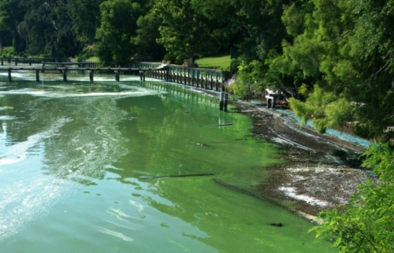
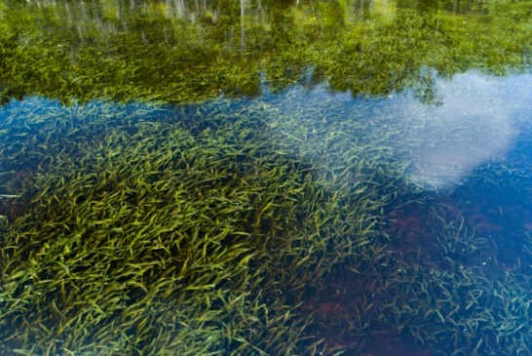
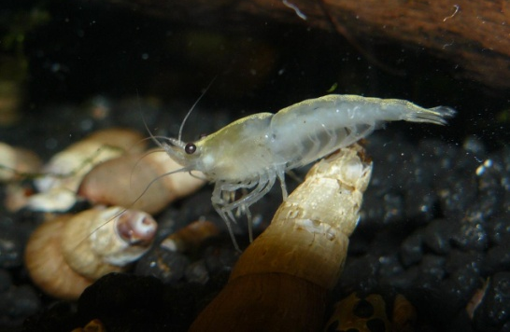
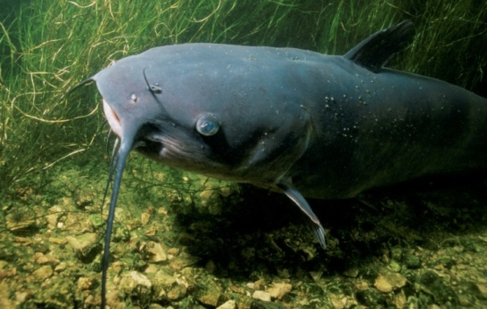
ECOLOGICAL MODELING OVERVIEW
11
EFDC Model
Water circulation and salinity
Ecological Models
Wetland vegetation
Submerged aquatic vegetation (eelgrass)
Benthic macroinvertebrates (shrimp, crab, clams, mussels, worms)
Fish
Plankton
Water Quality Model
EFDC/CE-QUAL-ICM
BUILDING STRONG®
US ARMY CORPS OF ENGINEERS | Jacksonville District

Slide 12
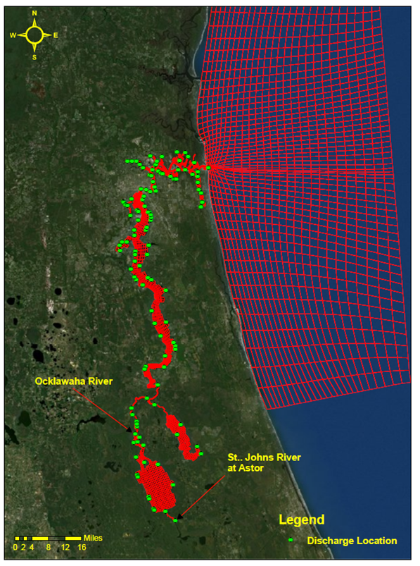
12
EFDC CIRCULATION AND SALINITY MODEL
Model conditions and inputs
4,824 cells, 6 vertical layers
Ocean water level
Rainfall and Evaporation
Wind
Salinity
Lateral inflows
1995 land use

Slide 13
13
LOWER ST. JOHNS RIVER ANNUAL FLOW
The 3-year period, 1999 - 2001, is lowest 3 consecutive year flow in the 78 year record
Evaluation Period
Discharge (cfs)
Year

Slide 14
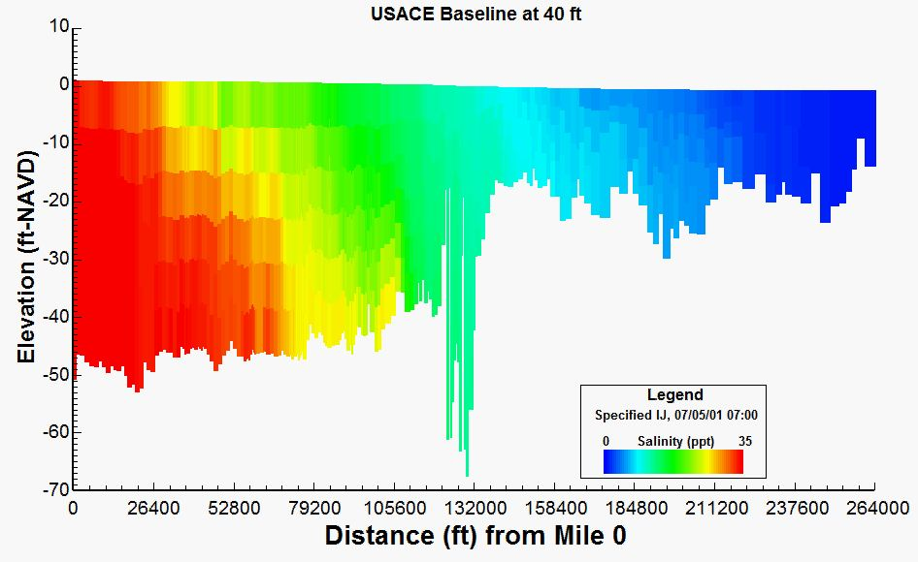
14
EFDC RESULTS
Baseline at 40-foot project depth - salinity profile
Shands Bridge
Buckman Bridge
River Mouth
Dames Point Bridge
Acosta Bridge

Slide 15
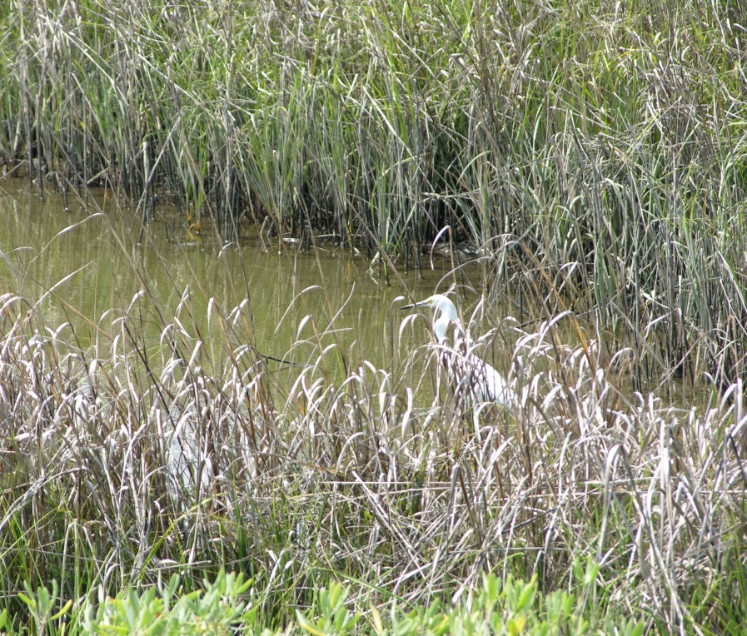
WETLAND VEGETATION MODEL
15
Evaluation Topic
Wetland (marsh, swamp) shift due to salinity change
Evaluation Method
Wetland boundaries defined by salinity “break points”
Modeled salinity movement predicts community boundary and areal change

Slide 16
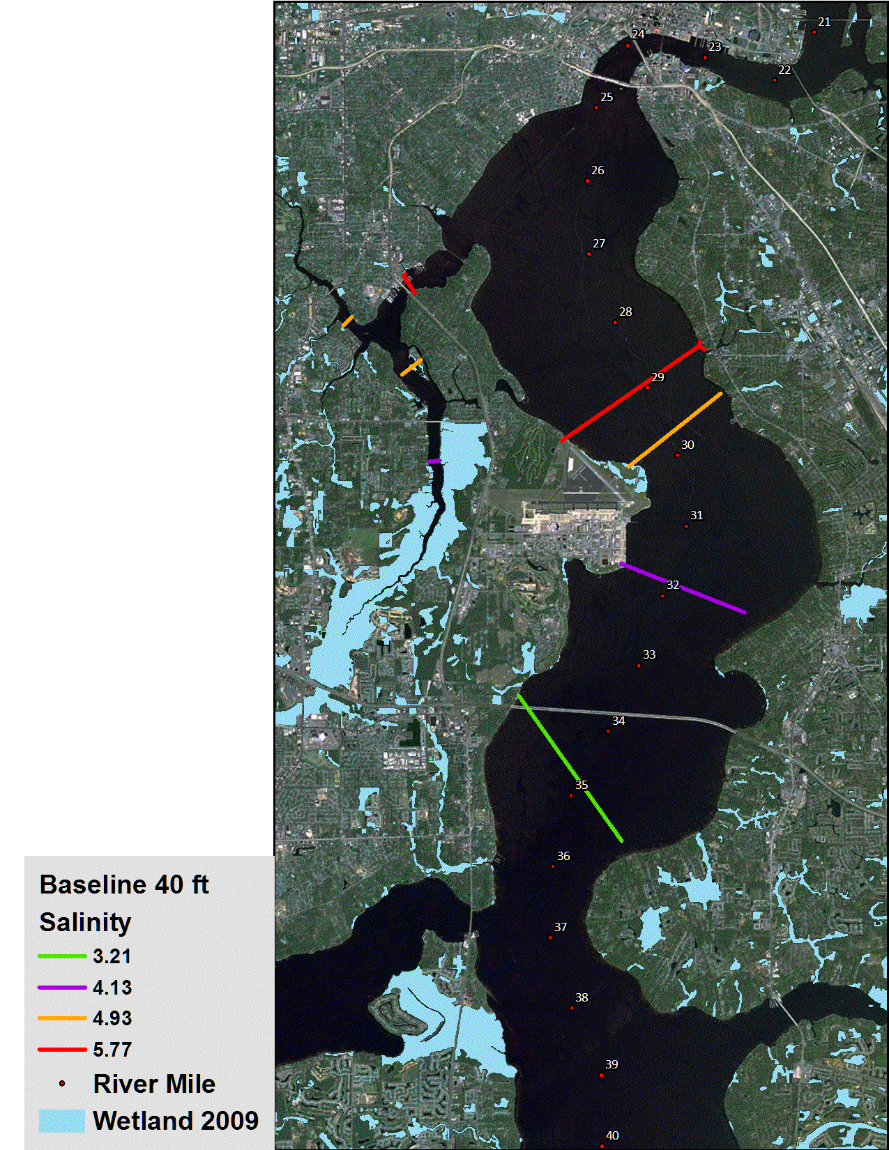
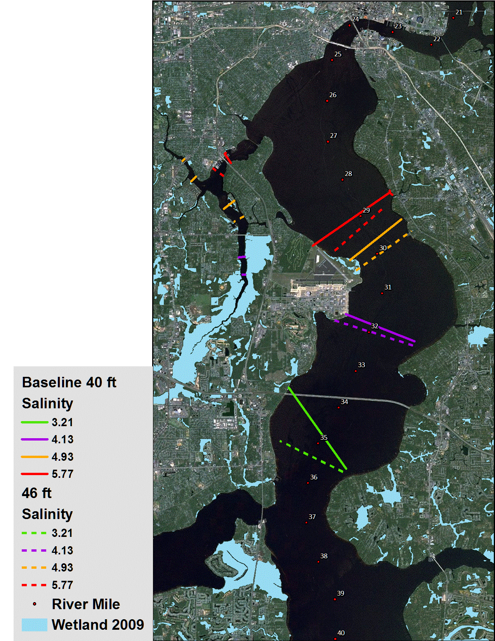
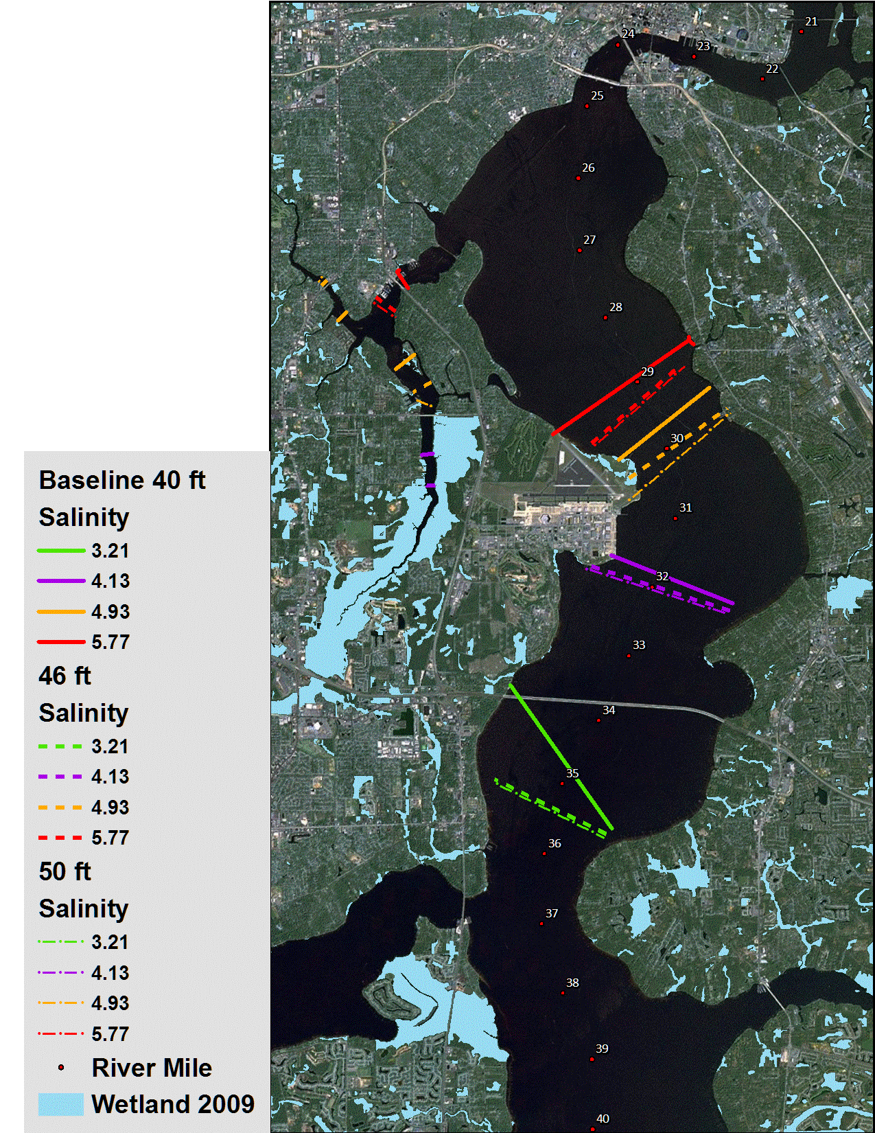
WETLAND VEGETATION MODEL
16
Salinity Breakpoints
Current Condition

Slide 17
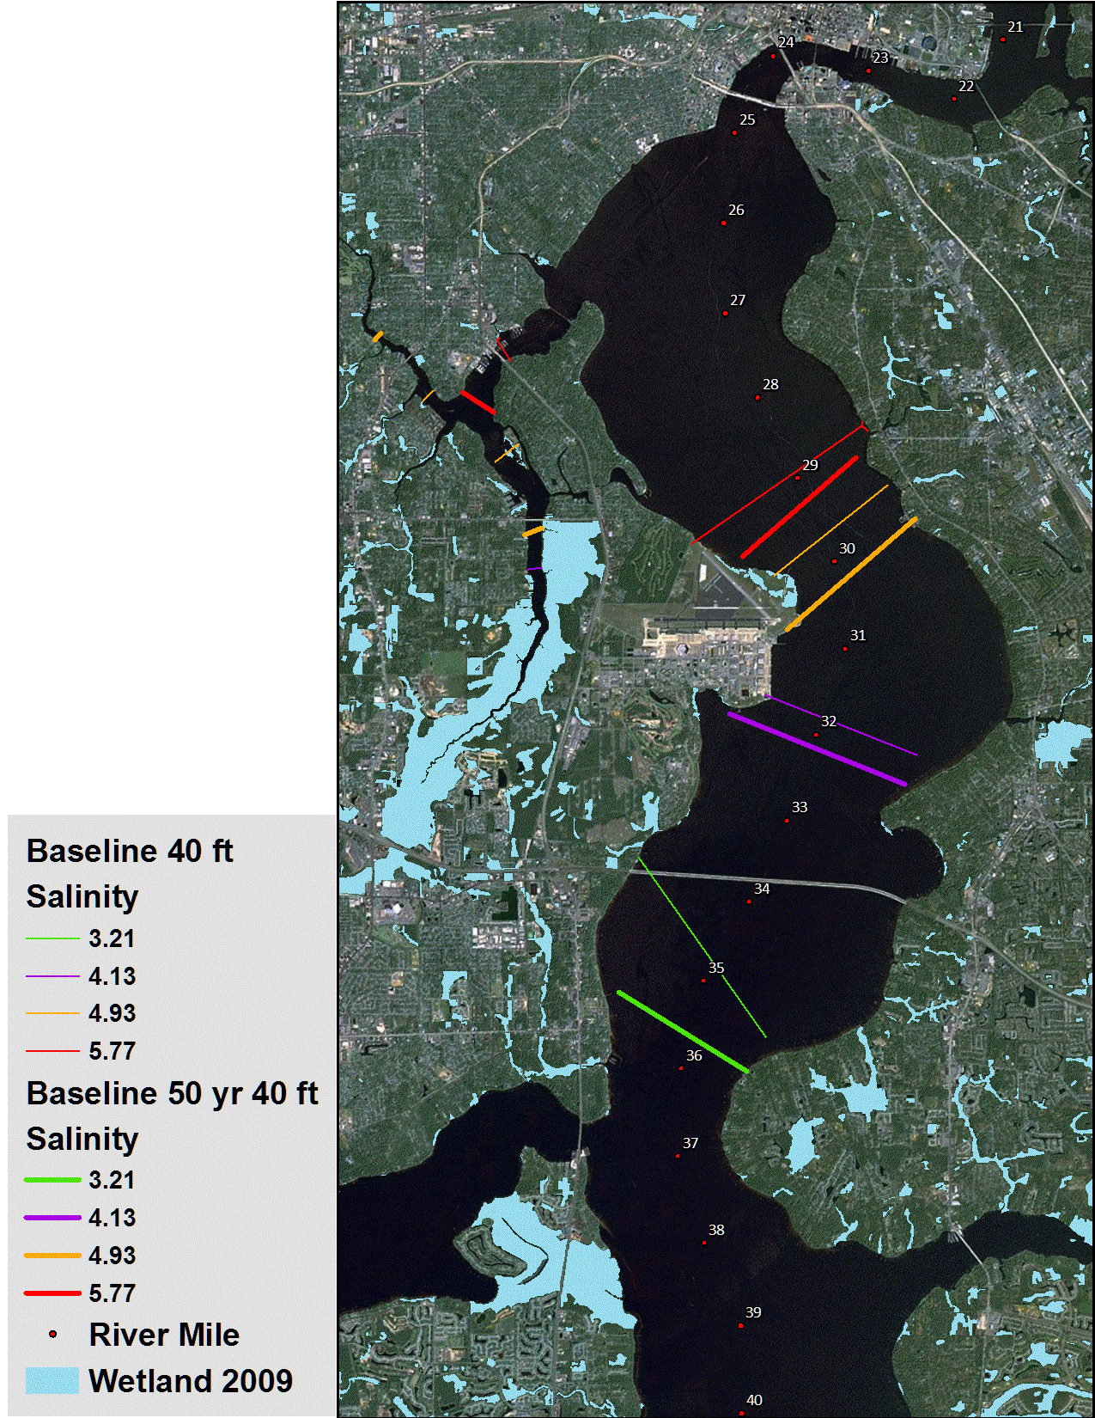
WETLAND VEGETATION MODEL
17
Salinity Breakpoints
50-year Horizon

Slide 18
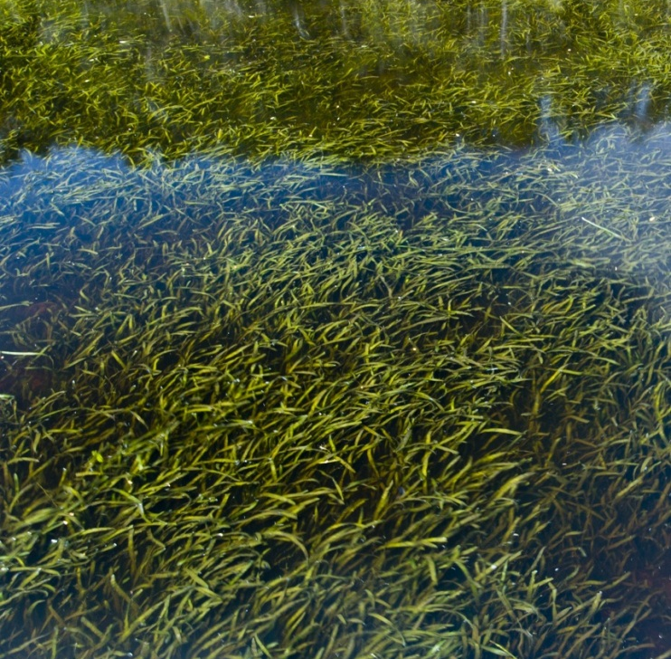
SUBMERGED AQUATIC VEGETATION (SAV) MODEL
18
Evaluation Topic
Salinity stress on eelgrass
Evaluation Method
90-day average salinity
Individual model cells
Total area affected

Slide 19
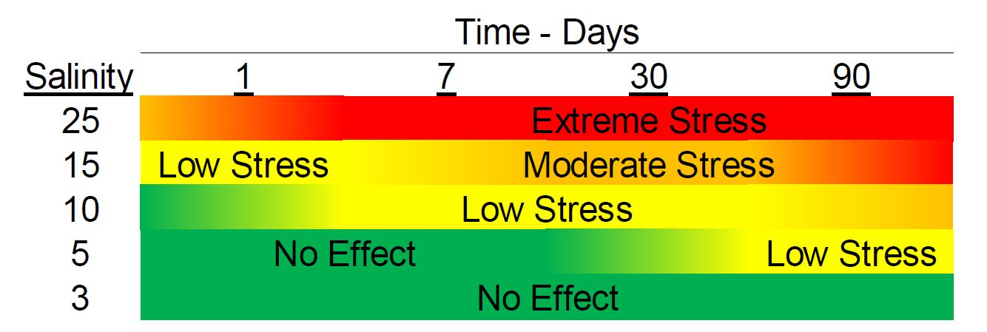
19
SUBMERGED AQUATIC VEGETATION (SAV) MODEL

Slide 20
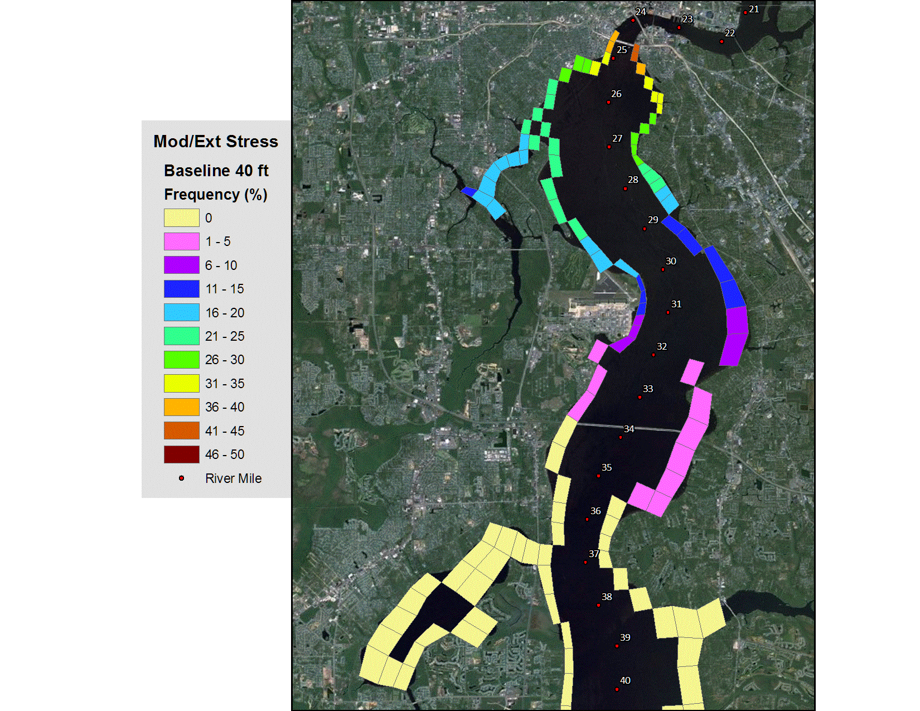
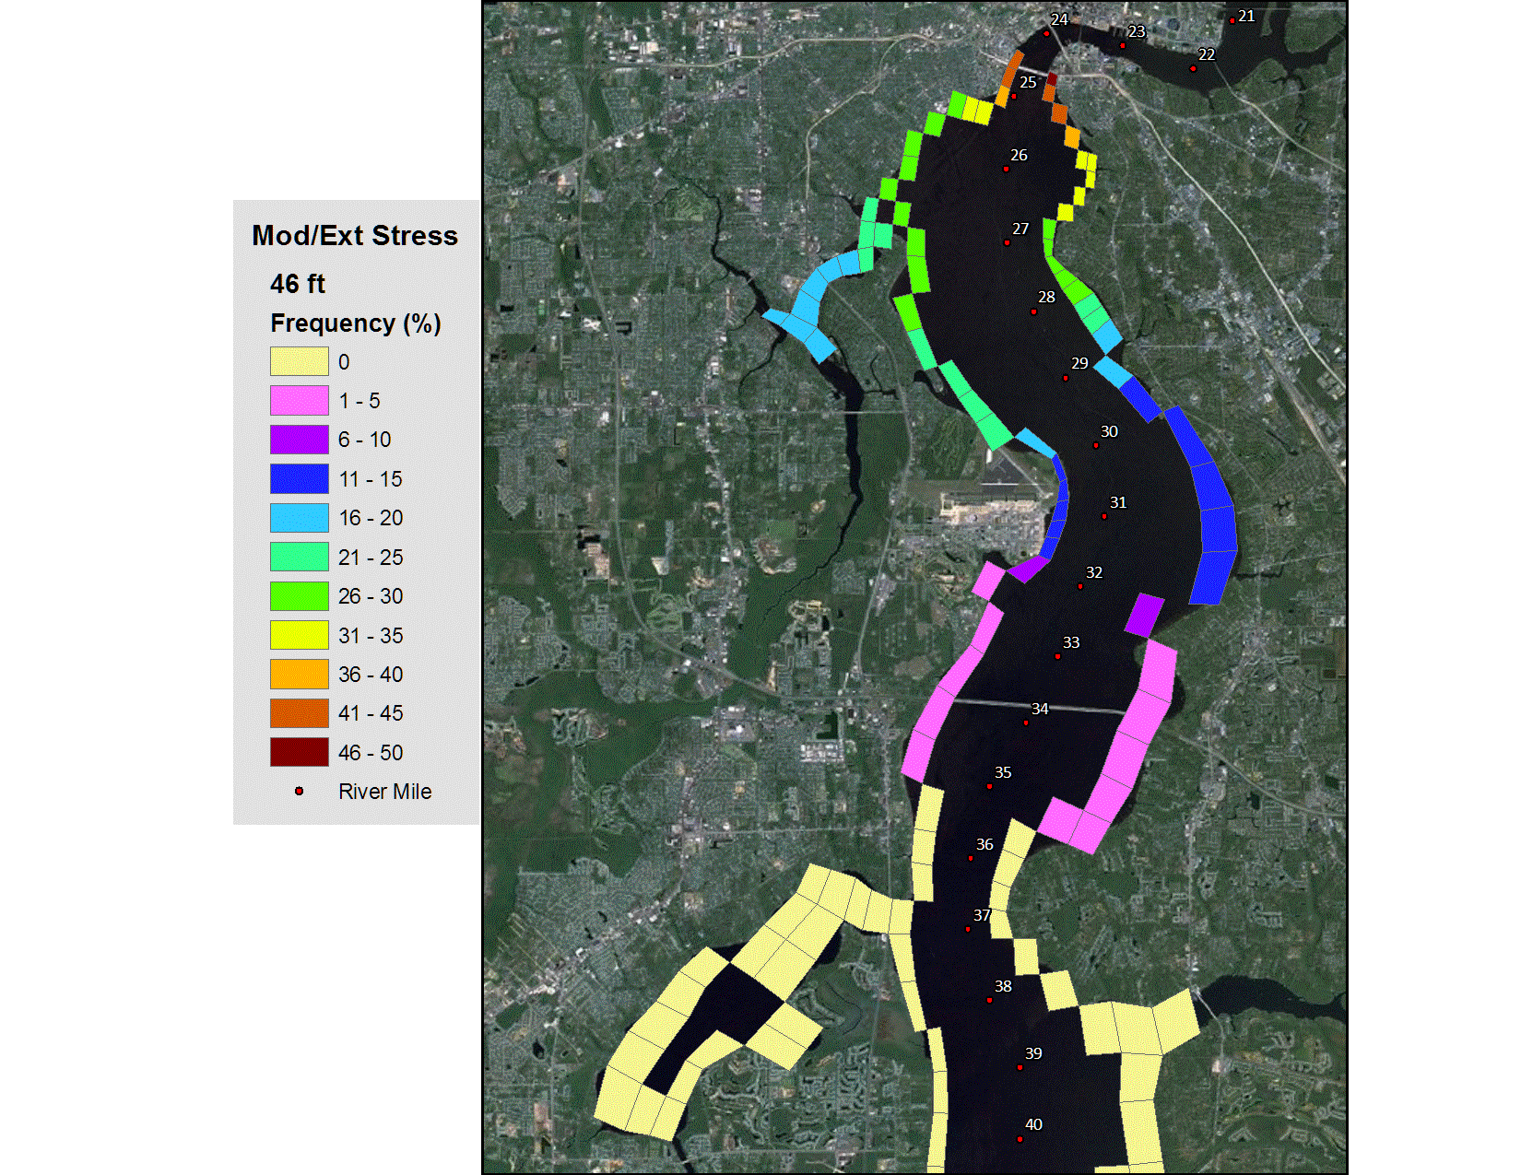
20
SUBMERGED AQUATIC VEGETATION (SAV) MODEL

Slide 21
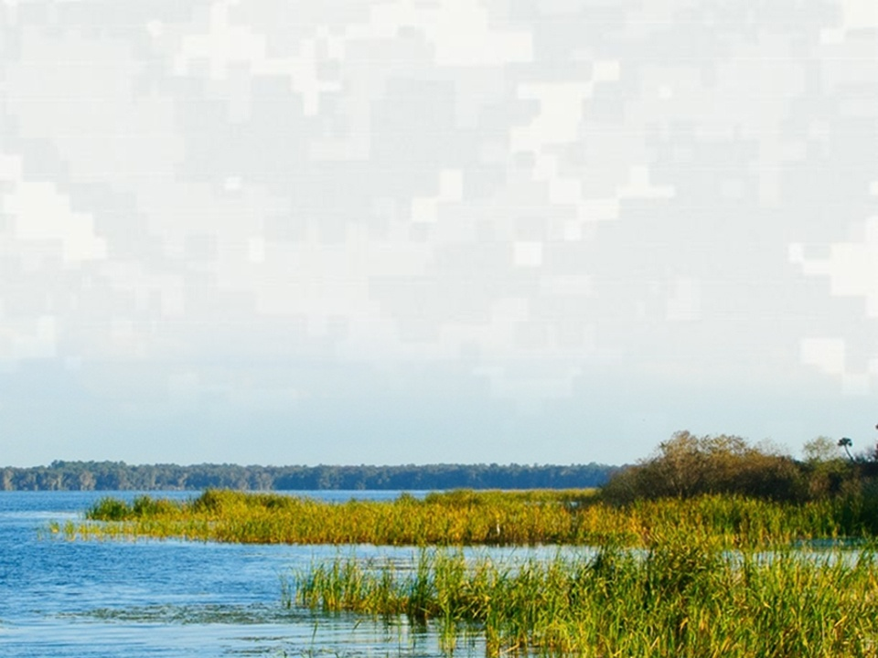
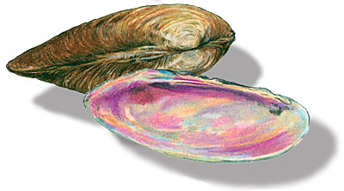
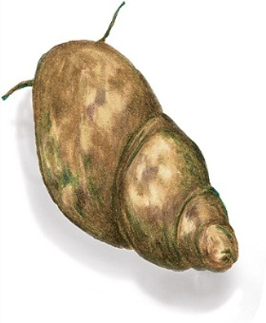
BENTHIC MACROINVERTEBRATE (BMI) MODEL
21
Evaluation Topic
BMI habitat area and BMI abundance
Evaluation Methods
Changes in area (acres) and location of salinity zones
Changes in duration and level of salinity (Partial Duration Frequency Analysis – PDFA)
Total BMI abundance
BUILDING STRONG®
US ARMY CORPS OF ENGINEERS | Jacksonville District

Slide 22
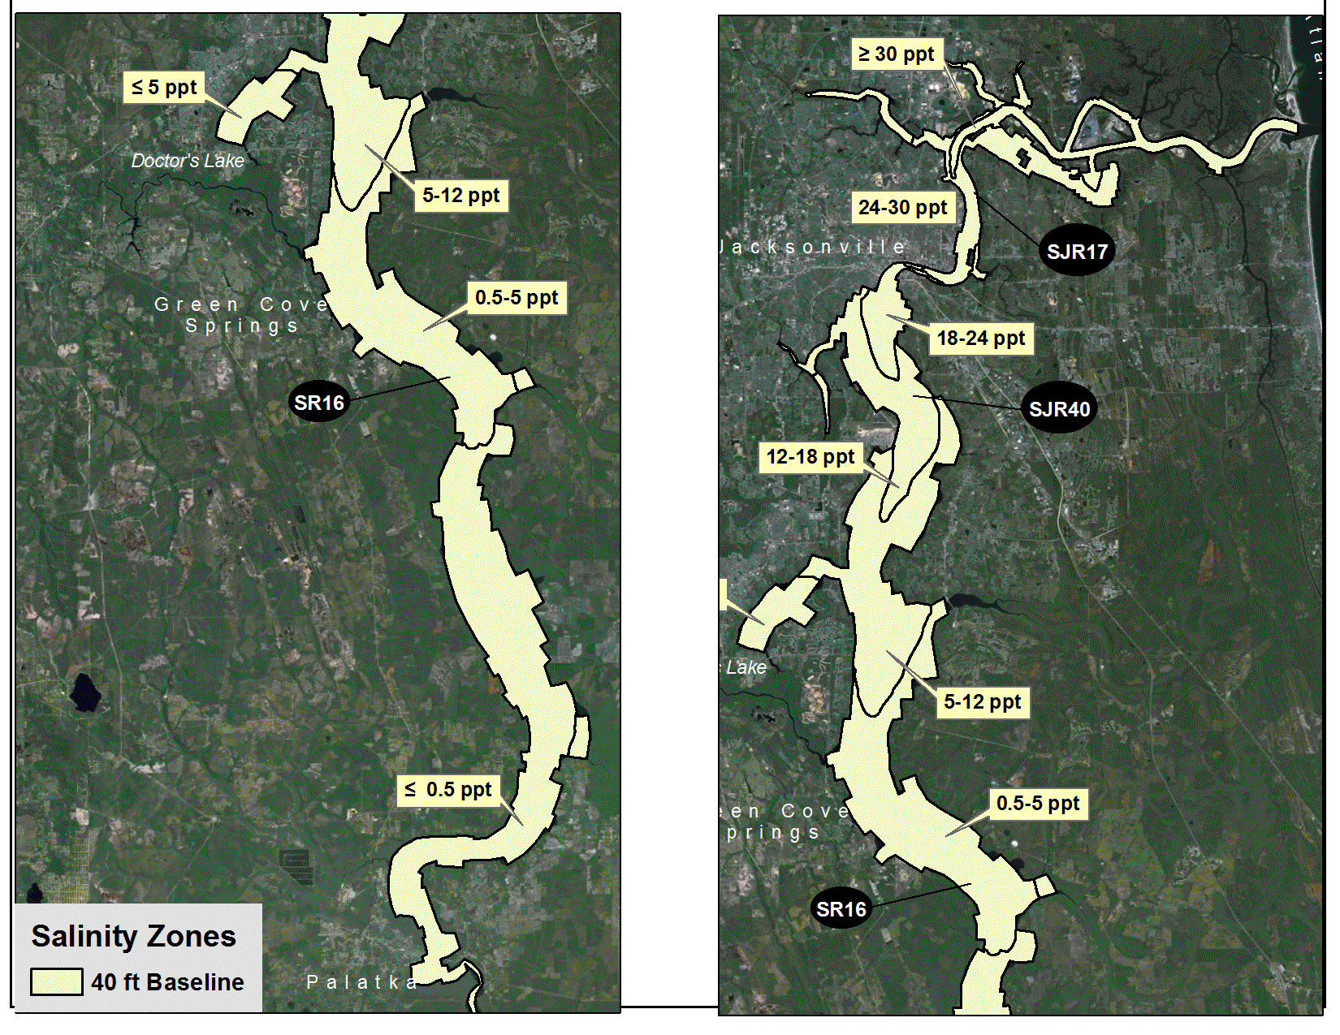
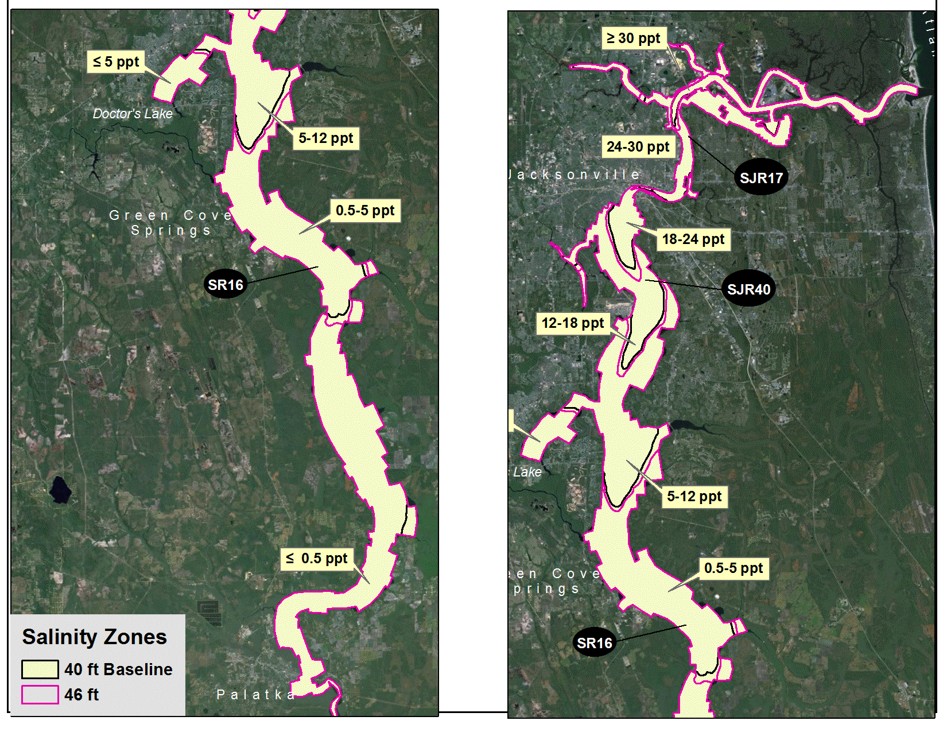
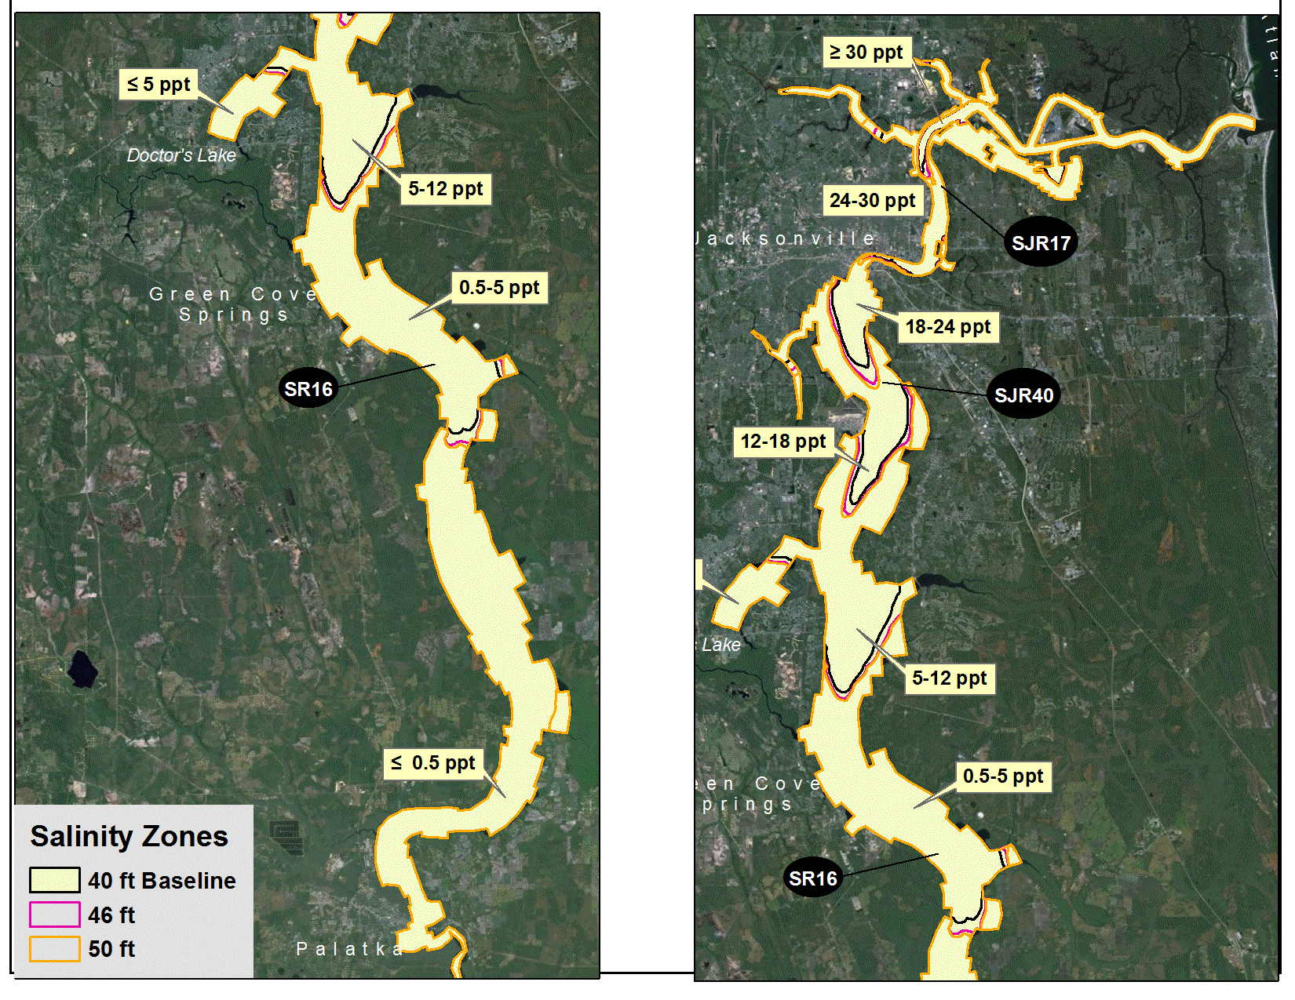
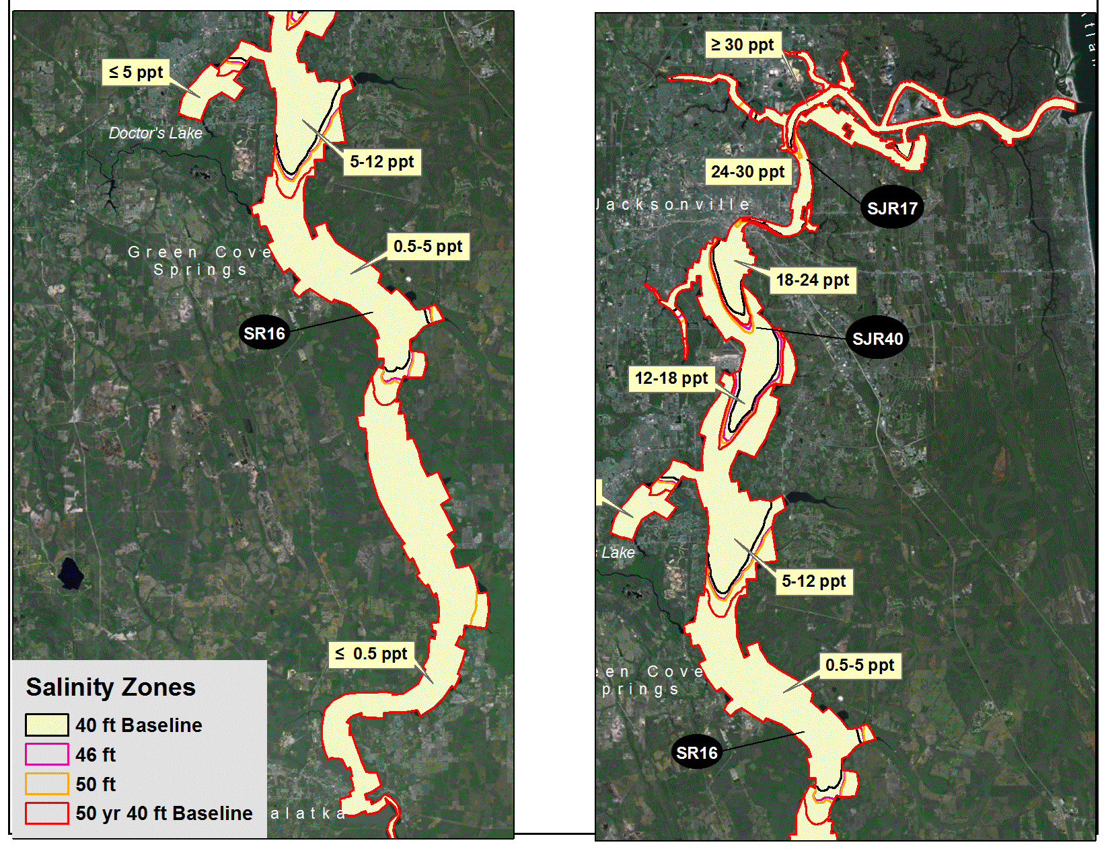
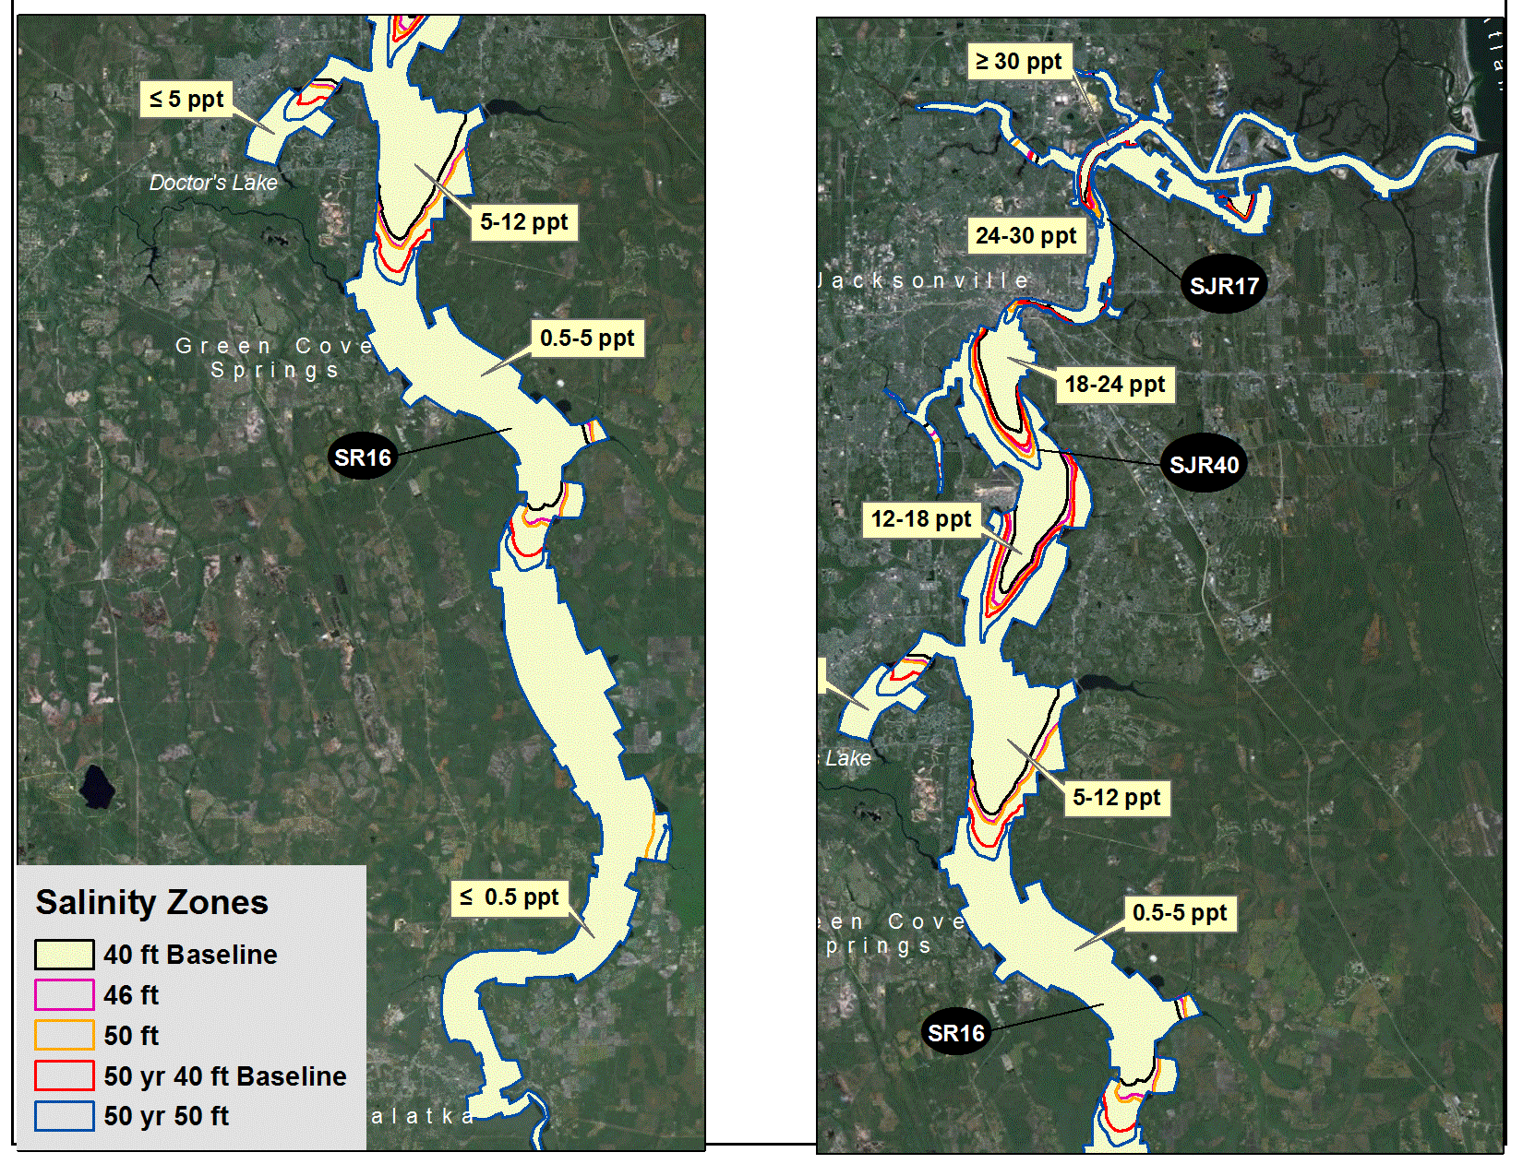
22
BMI SALINITY ZONES MAX 30-D, 1997

Slide 23
23
BENTHIC MACROINVERTEBRATE (BMI) MODELS
Preliminary Results
Small changes in maximum river bottom salinities, and corresponding small changes in BMI abundance
Elevated salinities occur primarily between Fuller Warren Bridge and Shands Bridge
Salinity zones affected less by deepening than by year to year changes in river flows
Changes expected with 50 years of projected sea level rise and 155 million gallons per day (mgd) water withdrawal exceed effects of different channel depths

Slide 24
FISH MODEL
24
Evaluation Topic
Fish Habitat area
Evaluation Methods
Changes in area of each salinity category
Changes in SAV cover
Fish species require various salinity levels for different stages in their life cycle

Slide 25
25
FISH MODEL
Preliminary Results
Modeling results of the study alternatives depict minor upstream shifts in salinity zones
Salinity zones affected less by deepening than by year to year changes in river flows
These preliminary results indicate that fish habitat within the main stem of the river would not be adversely impacted
Analysis is ongoing for potential effects on fish habitat within the tributary and marsh areas

Slide 26
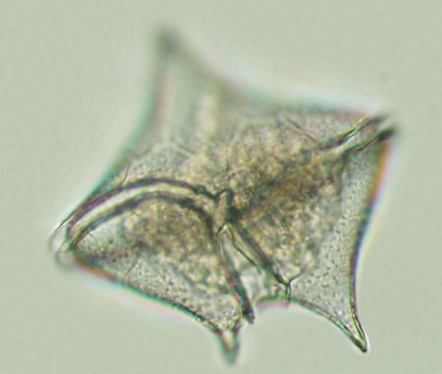
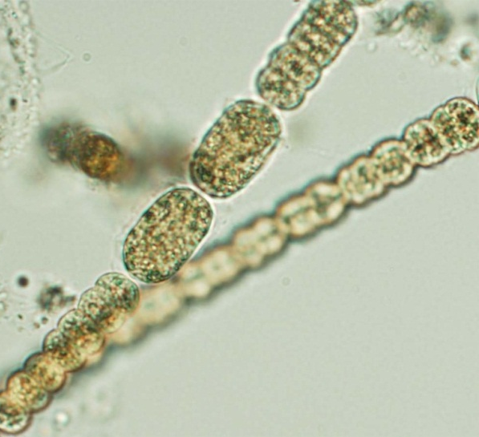
PLANKTON MODELS
26
Evaluation Topics (algal bloom metrics)
Marine algal blooms
Nitrogen (N) loading via N₂-fixation
Freshwater bloom magnitude (chlorophyll-a maximum/dissolved oxygen minimum)
Freshwater bloom duration
Evaluation Method
Regression models based on water age

Slide 27
27
PLANKTON MODELS
Preliminary Results
Preliminary results are inconclusive
Evaluation and analysis is ongoing

Slide 28
WATER QUALITY EVALUATION
28
Evaluation Topics
Chlorophyll-a (for comparison to plankton empirical model)
Dissolved Oxygen (relative to TMDL)
Evaluation Method
EFDC Model
CE-QUAL-ICM Model

Slide 29
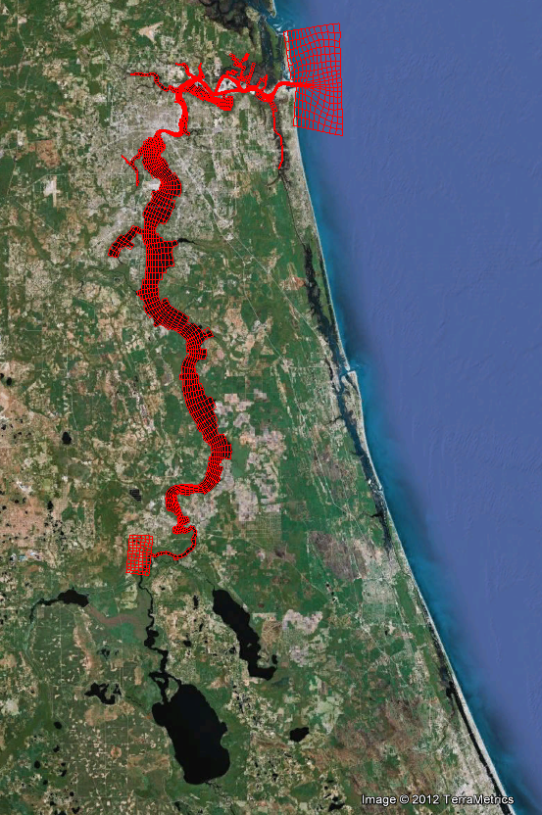
29
EFDC-CEQUAL-ICM Model Mesh
Model conditions
2,707 cells, 6 vertical layers
Model output variables
Water surface elevation
Velocity
Salinity
EFDC output delivered to CEQUAL-ICM water quality model
Model is calibrated and alternative runs are in-progress
AIWW
Atlantic Ocean
St. Johns River
Crescent Lake
Lake George

Slide 30
30
PRELIMINARY RESULTS SUMMARY
Circulation model effectively simulates water movement, elevation and salinity
The ecological models indicate some effects with study alternatives (including the no action alternative)
Preliminary effects appear greatest for SAV and wetlands
Effects due to sea level rise and water withdrawal at 50-year horizon generally exceed initial effects of any study alternative
Additional alternative simulations and analysis are underway or planned

Slide 31
JACKSONVILLE HARBOR DEEPENING STUDY WEBSITE WWW.SAJ.USACE.ARMY.MIL
31

Slide 32
32
QUESTIONS?
Certain photos courtesy of the St. Johns River Water Management District and JAXPORT.
BUILDING STRONG®
US ARMY CORPS OF ENGINEERS | Jacksonville District

